Slide 1
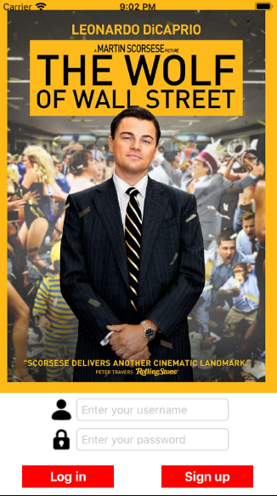
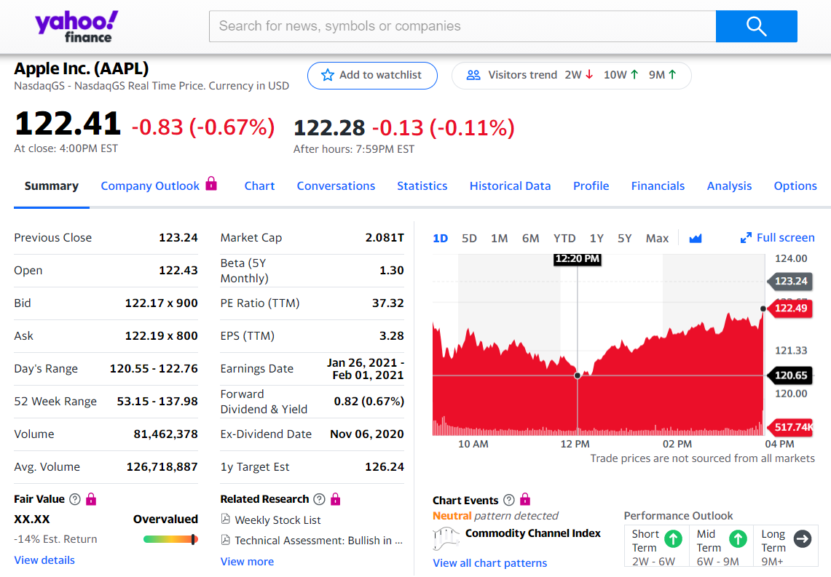


StockTracker
Customize your own stock info
Mobile Yahoo Finance Database.
Strategies for quantitative trading
Want to get a free lunch?
A stock based social media
Instant collection, share, signals, and chat.
→ StockMancer
StockMancer
Credit to Neuromancer
Chenning Li, Danqi Qu MSU
1
Notes:
Hello, everyone. I’m Chenning Li, from Michigan State University. And our project is “ Stock Tracker”.
Since March, the stock trading APP, Robinhood, has millions of new users and billions of dollors are pouring into the stock market, which inspires me to develop the stock tracker.
First, for retail traders, they want to access to the massive stock data and customize it freely. Just like an editable Yahoo Finance for Users.
Second, different from robinhood and chase, we want to explore the potential of quantitative trading strategies, which can send users signals to buy or sell some stocks. Users must love it since everyone wants a free lunch.
Third, we expect it to be a stock-based social media, which supports the instant information collection and share. It must be profitable since retail traders are always prone to be crazy with money.
Inspired by the hot game Cyberpunk 2077, I would like to call it the stockMancer, to connect every retail traders for fun.

Slide 2
Now: A basic APP
5 complete and stable stock APIs.
More than 200 data to parse.
8 view pages with shared data.
Make users as the developer.
Future: a social platform
Instant info collection from Reddit, Twitter for signals.
Stock-based social media.
Potentials for quantitative trading.
2
Notes:
This page shows our prototype and future work.
Currently, it’s more like a basic APP with detailed stock information.
To achieve it, we rely on 5 stable stock APIs from Yahoo Finance. And massive financial data has to be parsed and interacted.
We now have 8 view pages, covering Quote Summary, historical chart, news, search and stock trends.
And users can edit the watchlist and stocks freely, look up current news and hot stocks.
We have more expectations for our project to be a social platform.
First, it can be an all-in-one stock platform, to collect the instant information from Reddit, Twitter, which can be distributed and shared among users. For me, I purchased the Rocket stocks and often look up information in the sub-reddit team-rocket.
Further, it can be a stock social media, where people can chat for specific stocks, sectors or companies.
Meanwhile, we can also explore the potential strategies for quantitative trading, such as the candlestick, or even deep learning and big data.

